Slide 1
Unit- III: Funding the Growth & Building the A-Team
Overview of Funding,
Funding options for an entrepreneur,
Explore the right funding options,
Create Funding Plan,
Pitch Deck,
Introduction to building A-Team,
Pitching to attract the talent,
Setting your team,
Hiring the A-Team members
Defining roles
.

Slide 2
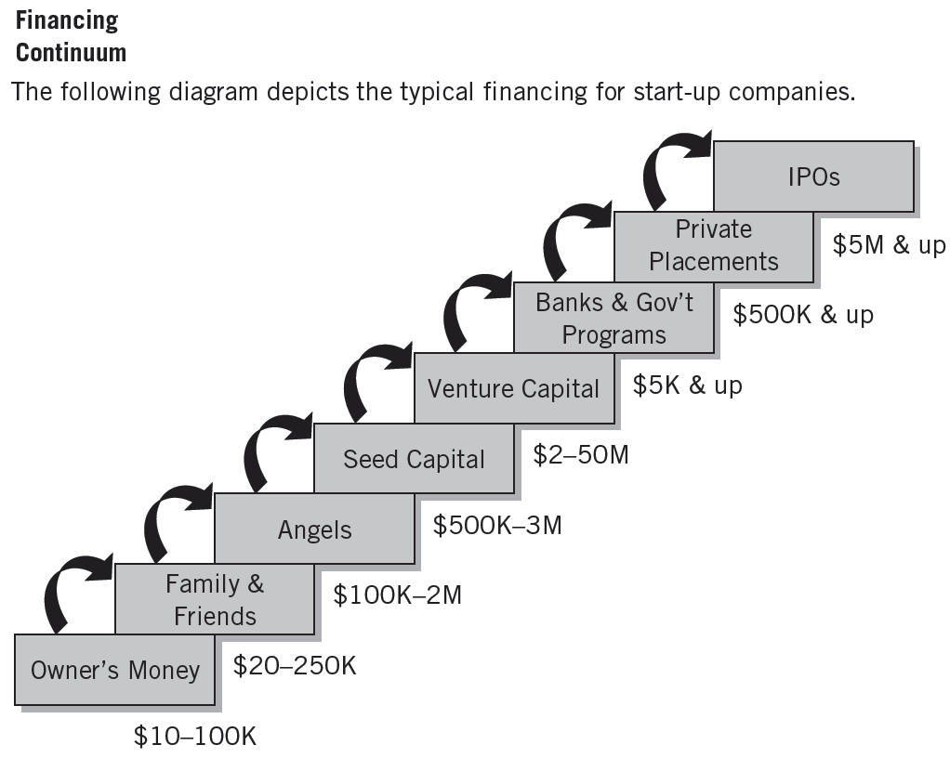

Overview of Funding

Slide 3
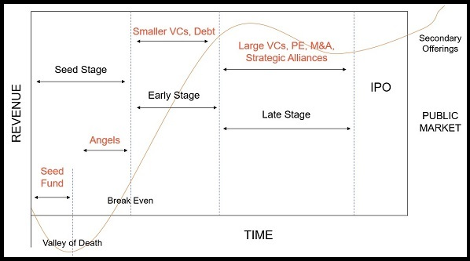
Funding Stages

Slide 4
Funding options for an Entrepreneur,
Equity Sources:
Personal Sources
Private Borrowings
Informal Capital
Corporate Securities
Public Issues
Internal Financing
Debt Sources:
Debentures
Commercial Papers
Inter-corporate deposits
Public Deposits
Institutional sources
Commercial Banks
Non-Institutional Arrangements (Hire, Rent and Leasing)

Slide 5
Equity Capital Vs Debt Capital
Characteristics of Investment | Equity Financing | Debt Financing
Nature | There is no component of repayment of the invested funds. | Invested Funds to be repaid within a stipulated time frame with interest
Risk factor for the investor | Higher as he has no guarantee against his investment | Lower as he generally has collateral against his investment
Pressure of Repayment for startups | Less pressure to adhere to a repayment timeline but added pressure from investors to achieve growth targets | More pressure to adhere to repayment timeline and as a result more pressure to generate cash flows to meet interest repayments
Return to Investor | Capital growth for investors | Interest payments
Involvement in Decision making | Investors usually prefer to involve themselves in decision making process | Debt Fund have very less involvement.
Sources | Angel Investors, Self-financing, Family and Friends, Venture Capitalists, Crowd Funding, Incubators/Accelerators | Banks, Non-Banking Financial Institutions, Government Loan Schemes (Example: Mudra Loan)

Slide 6
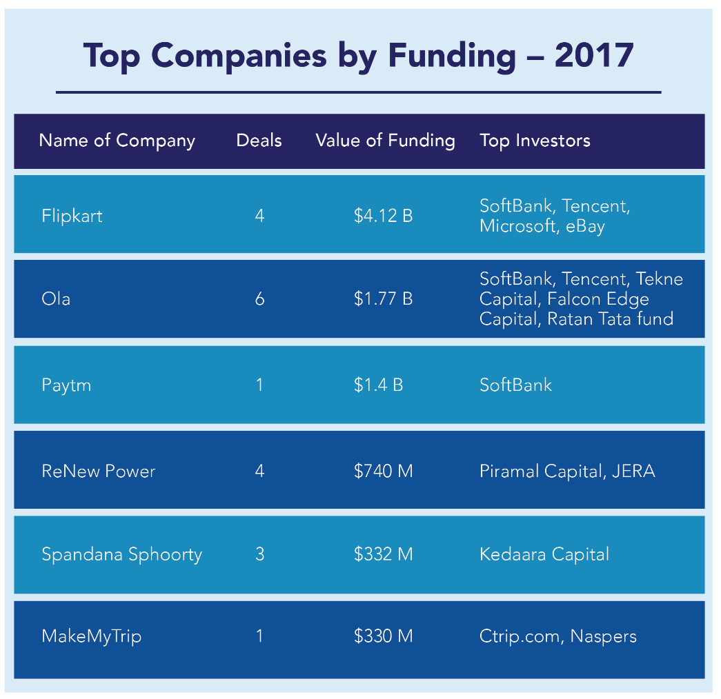

Slide 7
Bootstrapping
Bootstrap financing is probably one of the best and most inexpensive routes an entrepreneur can explore when raising capital.
Bootstrap financing is a way to pull yourself up without the help of others.
Advantages:
Business will be worth more because less money has been borrowed.
Need not have to pay the high interest on borrowed money.
Creative in finding ways to raise profits, without having to look to external sources.

Slide 8
Bootstrapping
Examples of bootstrapped enterprises:
Dell Computers
Facebook Inc.
Apple Inc.
Clorox Co.
Coca Cola Co.
Hewlett-Packard
Microsoft Corp.
Oracle Corp.)
eBay Inc.
Cisco Systems Inc.
SAP

Slide 9
Bootstrapping – Three Funding Stages
Beginning Stage: This stage normally starts with some personal savings, or borrowed or investment money from friends and family, or as a side.
Customer-Funded Stage: Money from customers is used to keep the business operating and, eventually, funds growth.
Credit Stage: The entrepreneur focuses on the funding of specific activities, such as improving equipment, hiring staff, etc. At this stage, the company takes out loans or may even find venture capital, for expansion.

Slide 10
Source Of Bootstrap Financing
Source Of Bootstrap Financing
Trade Credit
Factoring
Customers
Real-estate
Equipment Suppliers
Conditional Sales Contract
Chattel Mortgage Contract

Slide 11
1. Trade-Credit Normally, a supplier will extend you credit after you're a regular customer for 30, 60 or 90 days, without charging interest.
Example, suppose that a supplier ships something to you, and that bill is due in 30 days but you have trade credit or terms.
Your terms might be net 60 days from the receipt of goods, in which case you would have 30 extra days to pay for the items.
2. Factoring
This is a financing method where you actually sell your accounts receivable to a buyer such as a commercial finance company to raise capital.
A "factor" buys accounts receivable, usually at a discount rate that ranges between one and 15 percent.

Slide 12
Factoring can be performed on a non-notification basis. That means your customers aren't aware that their accounts have been sold.
The factor then becomes the creditor and assumes the task of collecting the receivables as well as doing what would've been your paperwork chores.
3.Customers Customers are another source of bootstrap financing, and there are several different ways to take advantage of these valuable assets.
One way to use your customers to obtain financing is by having them write you a letter of credit.
Example, suppose you're starting a business manufacturing industrial bags. A large corporation has placed an order with your firm for a steady flow of cloth bags.

Slide 13
The major supplier from which you will obtain the material the bags is located in India.
In this scenario, you obtain a letter of credit from your customer when the order is placed, and the material for the bags is purchased using the letter of credit as security.
4.Realestate Another bootstrap financing source is real estate.
The first is simply to lease your facility.
This reduces startup costs because it costs less to lease a facility than it does to buy one.
Also, when negotiating a lease, you may be able to arrange payments that correspond to seasonal peaks or growth patterns.

Slide 14
5. Equipment Suppliers
Instead of paying out cash for your equipment, you can purchase it with a loan from manufacturers;
In this way, equipment suppliers are a source of bootstrap financing.
Two types of credit contracts are commonly used to finance equipment purchases:
1. The conditional sales contract, in which the purchaser does not receive title to the equipment until it is fully paid for.
2. The chattel-mortgage contract, in which the equipment becomes the property of the purchaser on delivery, but the seller holds a mortgage claim against it until the amount specified in the contract is paid.

Slide 15

Angel Investors
A wealthy individual willing to invest own money in a business start-up. The term Angel investor was first used by William Wetzel .
An angel investor or angel (also known as a business angel, informal investor, angel funder, private investor, or seed investor) is an affluent individual who provides capital for a business start-up, usually in exchange for convertible debt or ownership equity.
Top Angel Investor in India
Rajan Anandan:
Anupam Gopal Mittal:
Sanjay Mehta:
Zishaan Hayath:
Sharad Sharma:
Anand Ladsariya:
Sunil Kalra

Slide 16
Angel Investment - Charactristics
An angel investor is usually a high-net-worth individual who funds startups at the early stages, often with their own money.
Angel investing is often the primary source of funding for many startups who find it more appealing than other, more predatory, forms of funding.
The support that angel investors provide startups fosters innovation which translates into economic growth.
These types of investments are risky.
Five Angle Investor Types:
The Family Investor
The Relationship Investor: a co-worker from a previous company or a business friend.
The Idea Investor: Investment is based on the idea and there is little emotional aspect.
The Once Removed Investor: Investor likely connected through a personal or professional relationship.
The "Archangel" Investor
An "Archangel" is a Relationship Investor or Idea Investor that has a track record of success making other Angels (and perhaps non Angels) money.

Slide 17
Angel Investors - FiveTypes
The Family Investor: The Family Investor is not really a classic Angel Investor but a supportive family member knowing the entrepreneur. Their motivation comes from the interest in supporting a family member or friend.
The Relationship Investor: The Relationship Investor is a co-worker from a previous company or a business friend known for a while. They want to be supportive on the one hand, but are also looking for a return.
The Idea Investor: Investment is based on the idea and there is little emotional aspect. Often an influential Idea Investor makes a good early board member for the company.
The Once Removed Investor: Investor likely connected through a personal or professional relationship with either the Relationship Investor or the Idea Investor.
The "Archangel" Investor: An "Archangel" is a Relationship Investor or Idea Investor that has a track record of success making other Angels (and perhaps non Angels) money. They have built a successful company in the same space, or have strong personal contacts with other Angel Investors.

Slide 18
Investment Profile Angel Investors
Investment Profile
Angel investments bear extremely high risks As such, they require a very high return on investment.
A large percentage of angel investments are lost completely when early stage companies fail, professional angel investors seek investments that have the potential to return at least ten or more times their original investment within 5 years, through initial public offering or an acquisition.
Current 'best practices' suggest that angels might do better setting their sights even higher, looking for companies that will have at least the potential to provide a 20x-30x return over a five- to seven-year holding period.
The actual effective internal rate of return for a typical successful portfolio of angel investments is, in reality, typically as 'low' as 20– 30%.

Slide 19

Venture Capitalists
They provide capital to young businesses in exchange for an ownership share of the business.
The SEBI defined Venture capital fund in its regulation 1996 as a fund established in the form of a company or trust which raises money through loans, donations, issues of securities of units as the case maybe and makes or proposes to make investments in accordance with regulations.
A venture capitalist is a person or investment firm that makes venture investments and these venture capitalists are expected as well as capital to their investments.
Characteristics of VCs
Well managerial skills
Well knowledgeable
Sophisticated investors-Comes forward to take risks
Decision making ability
Analyzing skills

Slide 20
Services generally provide by VCs
Finance to new and rapidly growing firms
Finance to typically knowledge based sustainable up scalable companies
Purchase equity and quasi equity securities
Assist in the development of new products or services
Add value to the company through active participation
Advantages of VC’s | Dis – Advantages of VC’s
Economy Oriented | Lengthy and Complex process
Investor Oriented | Deal in the negotiation
Entrepreneur Oriented | Investors becomes parts of owner’s business.

Slide 21
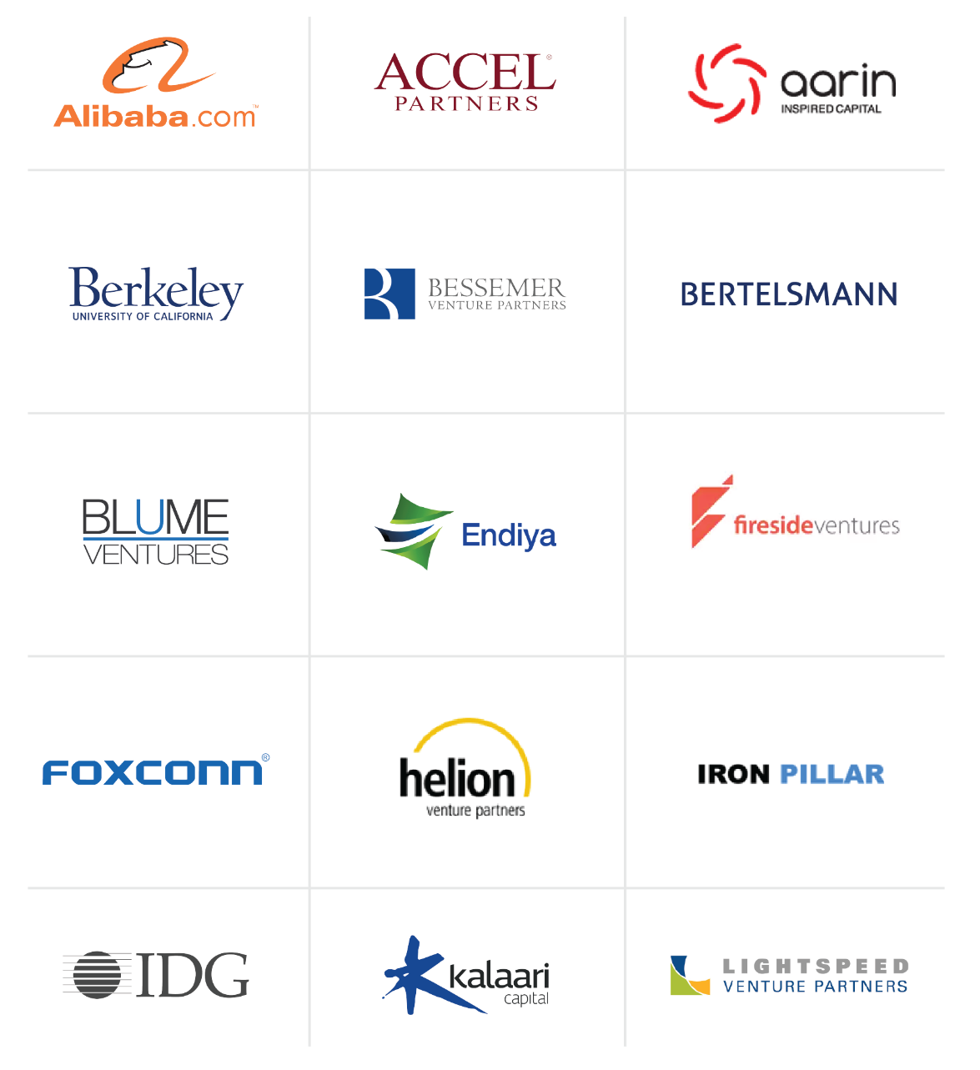
The most active Venture Capital Funds in India

Slide 22
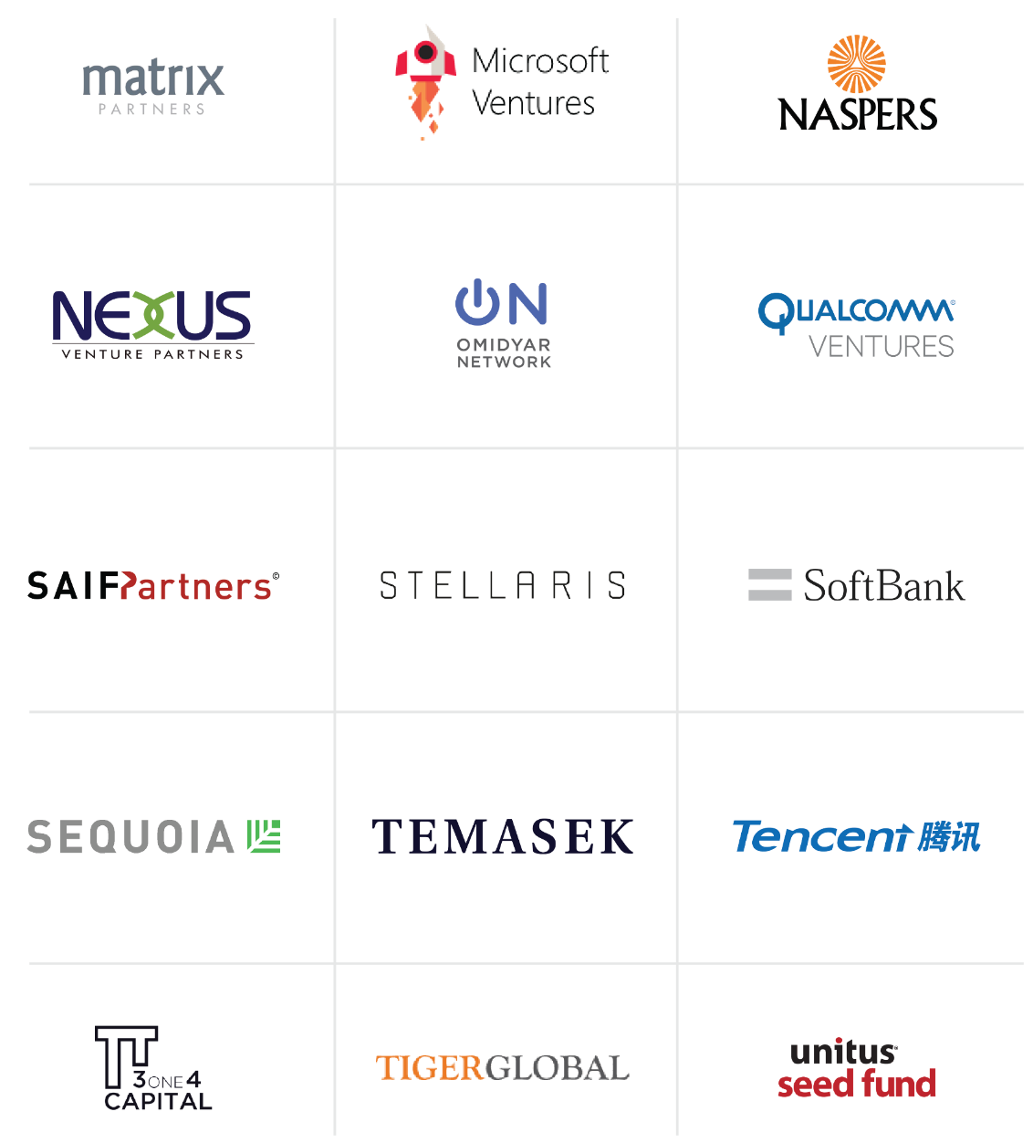
The most active Venture Capital funds in India

Slide 23
Venture Capitalists and Angel Investors
S.No | Venture Capitalists | Angel Investors
1. | A company or business rather than an individual | An individual investor
2. | Seldom interested in early-stage, unless compelling reasons (eg. high tech with already successful founders) | May be willing to invest in early-stage or start-up businesses, as well as established companies
3. | Investment amounts: More than £1 Million | Investment amounts: £10k - £100k, sometimes a bit more, groups could go up to £1m
4. | Invest in more mature and larger corporations and usually prefer to invest in companies that have established themselves and are looking for further investments to grow. | Angel investors usually invest in smaller startups with promising future outcomes.
5. | Require seat on board | May be willing to be "hands-off" or "hands-on" adding important skills

Slide 24
Incubators
Incubators are an organization, platform or team of experienced professionals that helps startups bootstrap during its early stages and often provides mentoring, guidance, co-working space and also at times some funding.
Traditionally incubators are the first port of call for any budding entrepreneur.
Incubators work on the same age old principles of providing the right assistance to fledging startups, but have proved to be a very important cog in the startup wheel.
Starting up needs active guidance, mentoring and a considerable amount of hand holding, something that an incubator can provide.
Experienced professionals and people who have been through the startup process often provide invaluable help and guidance.
For an early stage startup still in its bootstrapping phase, incubators make perfect sense.

Slide 25
Advantages of Incubators
Validation of Idea: An incubator helps an entrepreneur decide if his idea can address the market needs, carry out market research to determine the best mix, get feedback and also develop a market ready prototype.
Mentoring support: A young entrepreneur often needs mentoring about the various nuances of starting up. A mentor who has experience in starting up or possesses business acumen is a good sounding board and can help the founder in ironing out a lot of issues.
Co-working space: Co-working space with a number of other startups and entrepreneurs also become a vibrant and a melting pot of many ideas. Entrepreneurs at incubators often support each other in their endeavors and help ride difficult times.
Support in fund raising: Investors also like startups from incubators as they have a certain amount of faith on well known incubators and expect the ideas and startups to be vetted to a large extent.
Shared Resource Pool: Incubators often provides shared resource pool of rockstars experts in specific areas including technology which helps startup in faster realization of their idea.

Slide 26
Accelerators
A startup accelerator is an organization that offers mentorship, capital, and connections to investors and business partners. It’s designed for select startups with promising Minimum Viable Products(MVPs) and founders, as a way to rapidly scale growth.
Startup accelerators support early-stage, growth-driven companies through education, mentorship, and financing. Startups enter accelerators for a fixed-period of time, and as part of a cohort of companies.
The accelerator experience is a process of intense, rapid, and immersive education aimed at accelerating the life cycle of young innovative companies, compressing years’ worth of learning-by-doing into just a few months.
Accelerators are right for startups that are ready to scale.
Accelerators are intense and fast-paced, taking 3-6 months to get an early-stage startup ready for market.
Accelerators are predominantly focused on helping teams in the validation stage.

Slide 27
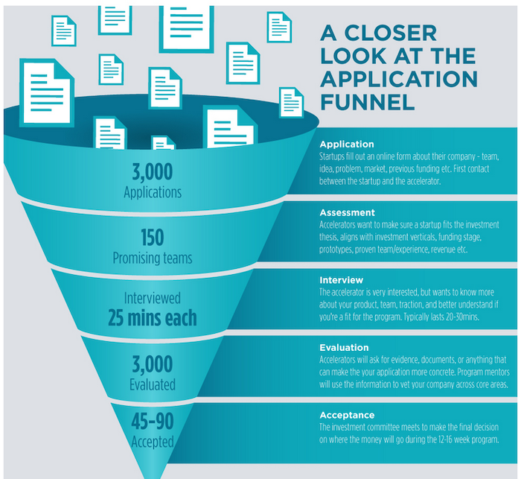
Accelerator Programme – Application Process
In most of the accelerators, the application process for startups is done in following stages:

Slide 28
Incubators VS Accelerators - Differences
S.N | Accelerators | Incubators
1. | Accelerators are funded by an existing company. | Incubators are often independent but can have connections to venture capital firms or universities.
2. | Accelerators are aimed at accelerating companies and scaling them up. | Incubators focus primarily on stimulating innovation (they incubate disruptive ideas).
3. | For Accelerators, a clearly delineated time frame of a few months is usually set. | Incubators are longer term—in many instances even taking years—and are more open-ended.
4. | At Accelerators, mentoring by the legacy company is a distinctive part of the program. | Incubators focus on larger numbers and are less selective.
5. | Accelerators have a much more structured program than Incubators and try to create a kind of alignment between the startups. | Incubators are more focused on creating an environment for co-creation.
6. | A proven startup in need of a cash injection to fuel growth needs accelerator. | Earlier-stage companies, or solo first-time founders, need guidance of an incubator.

Slide 29
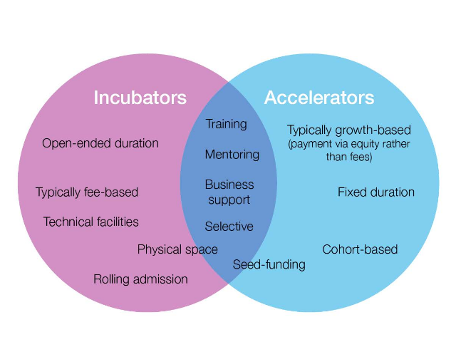
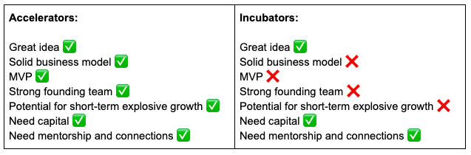
Incubators vs Accelerators

Slide 30
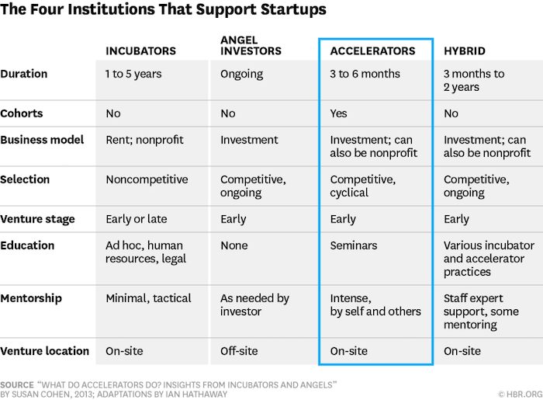
Institutions Supporting Startups - Summary

Slide 31
Crowd Funding
Accumulation of small investments in individual projects by large number of individuals (the “crowd”) via or with help of Internet and social networks.
“the collective effort of individuals who network and pool their money, usually via the Internet, to support efforts initiated by other people or organizations.”
Most crowd funding platforms specialize or focus on a specific area such as art, business or charities.
Examples
Crowd funder (specializes in business and tech start-ups)
Crowd rise (funds charities & causes)
Quirky (funds for inventors)
Invested.in (to create your own funding community)
Indiegogo (no specialization)

Slide 32
Types Of Crowd Funding Need to be Creative
Types of Crowd Funding
Rewards
Debt
Donation
Equity

Slide 33
1. Rewards-based, This type of crowd funding is likely to attract patrons, who invest because they enjoy your project or initiative and want to support it. The most popular reward-based sites are Kickstarter and Indiegogo.
Main advantage: you won’t launch your venture in debt (like in debt-based crowd funding),or give out shares of your project to patrons (like in equity-based crowd funding)
2. Donation-based, This type of fundraising is typical for a non-profit or a cause. Example : Go found me.
Main advantage: same as with rewards-based model, you don’t need to take a loan to launch your project.

Slide 34
3. Equity-based, This type of crowd funding is aimed towards technological, industrial and professional businesses and services rather than other causes. Examples of equity crowd funding aimed sites are Crowd cube, Fundable, Seedrs, and Fig.
Main advantage: you will be able to collect a larger amount of money, that will allow you to launch your business, and do it without taking credit.
4. Debt-based, also known as peer-to-peer (P2P). It is like a credit from the bank, but instead of borrowing one larger amount of money, you borrow smaller amounts from multiple people. Examples of debt-based crowd funding platforms are Funding Circle and Zopa.
Main advantage: There is no need to apply for a loan and go through the bank paperwork as well as to have a strict, demonstrable credibility that bank requires

Slide 35
Commercial Banks
Types of Bank Loans (Asset based)
Accounts receivable loans.
Inventory loans.
Equipment loans.
Real-estate loans.
Cash flow financing (Conventional bank loans)
Installment loans.
Straight commercial loans.
Long-term loans.
Character loans.

Slide 36
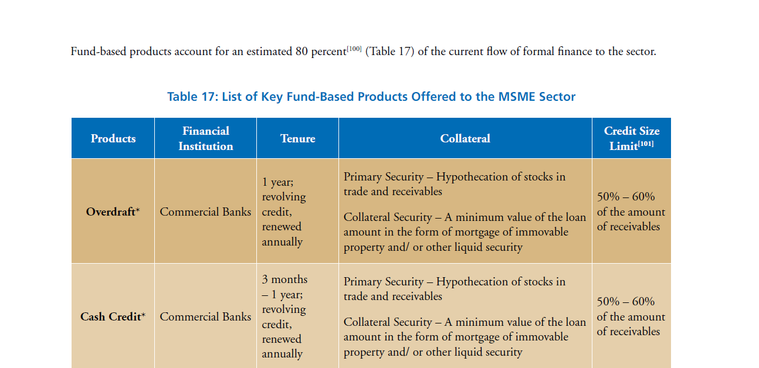

Slide 37
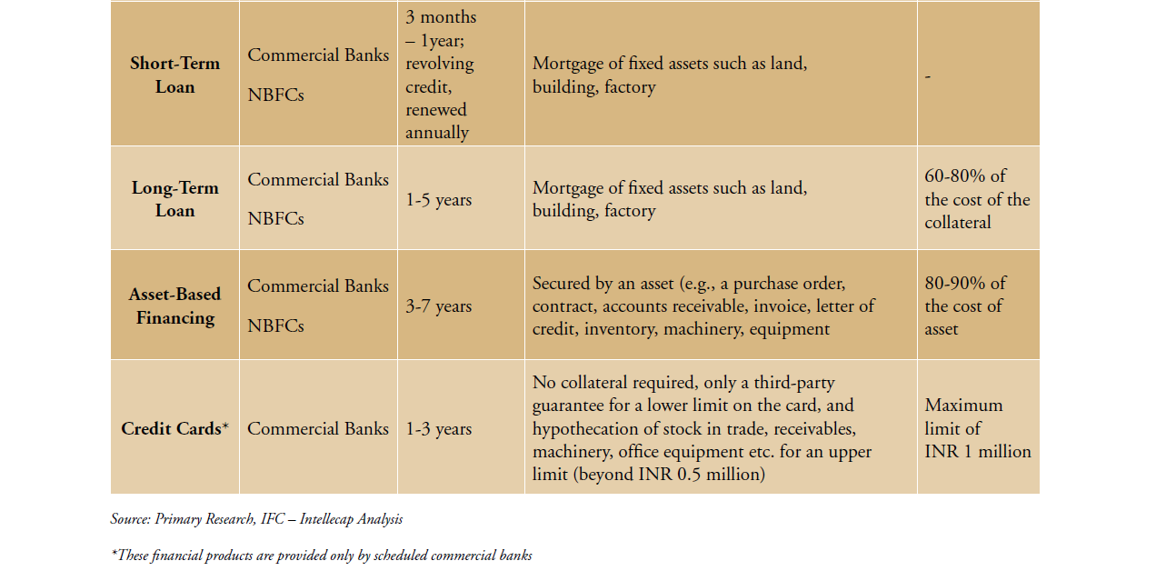

Slide 38
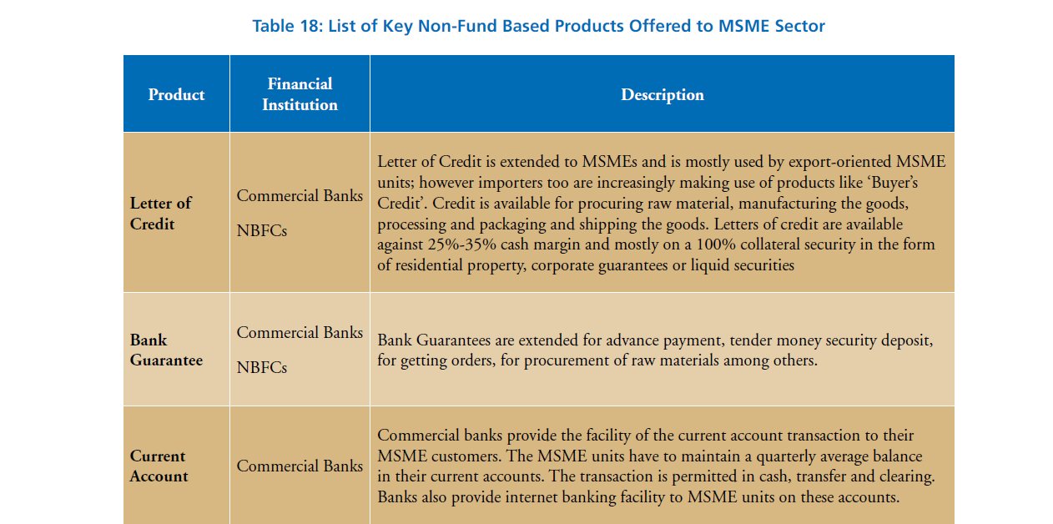

Slide 39
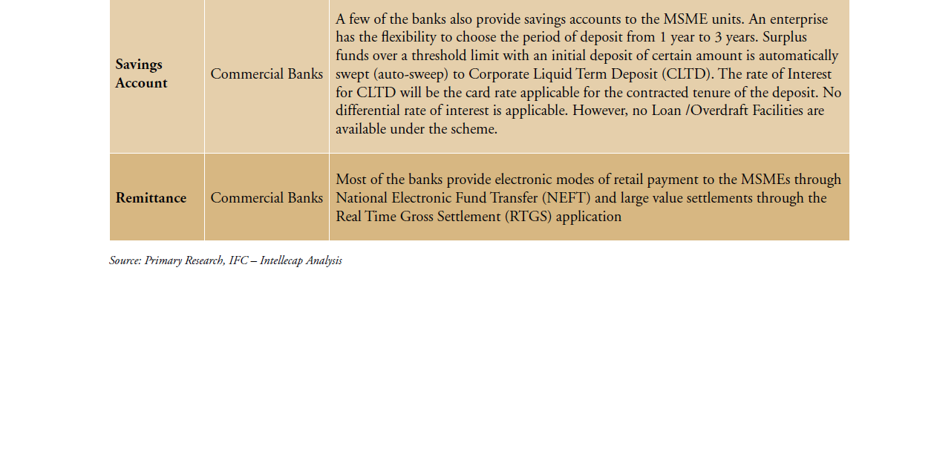

Slide 40
Create A Funding Plan
A funding plan is a document that outlines how an idea is going to be financed by an entrepreneur.
It helps in mapping out possible methods of income generation, identifying potential funders, and plan of developing your funding applications.
Components of a Good Funding Plan:
Identify the funding needs (how much money is needed and the purpose for which it is needed)
Identify potential methods of income generation – including self-generation of income (through selling products/services etc) and external sources of funding.
Identify potential funders and gather information on their application processes.
Plan out how and when you will go about applying for funds.

Slide 41
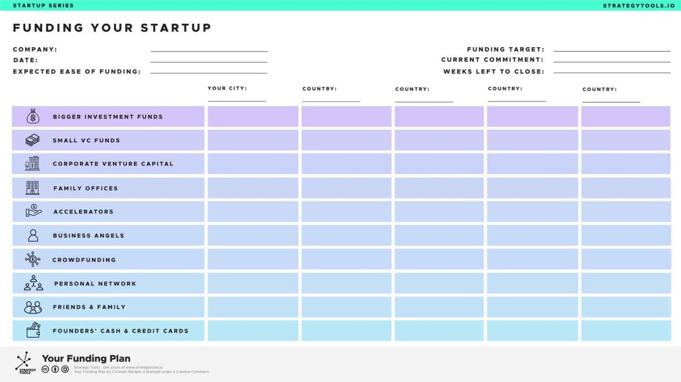
Create A Funding Plan
Plan out how and when you will go about applying for funds.

Slide 42
Pitch Deck
A pitch deck is a presentation deck that is used to pitch an idea or company to any number of audiences, generally investors.
It is a brief presentation that gives potential investors or clients an overview of the business plan, products, services and growth traction.
It is essential to organize a pitch deck based on the audience and forum to which it is being presented.
Key components to a pitch deck include high level summary slides, the problem being addressed, the product, the market/strategy, the team, financials/projections and the tone used to convey an idea.
A good rule of thumb is to include no more than 19 slides in a pitch deck.

Slide 43
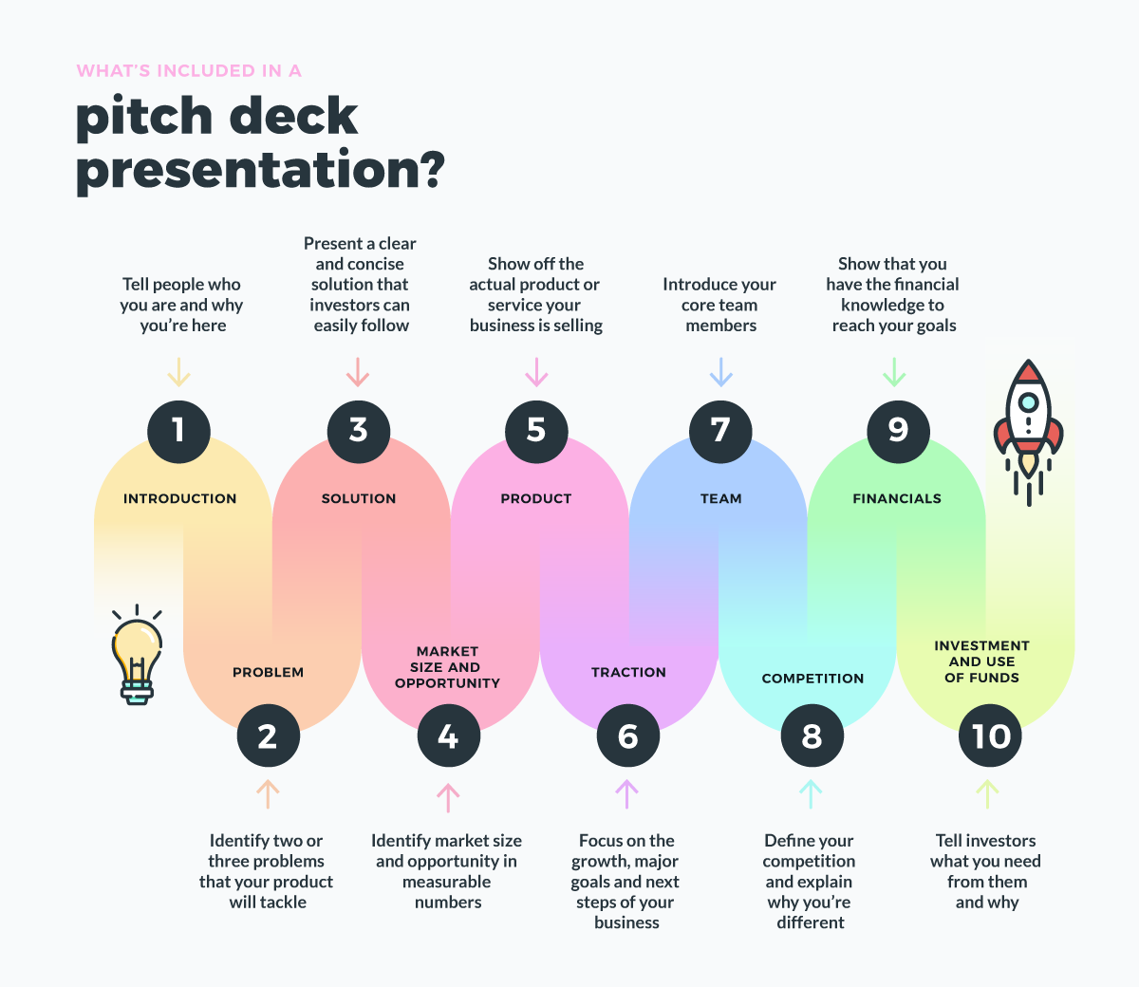
Pitch Deck

Slide 44
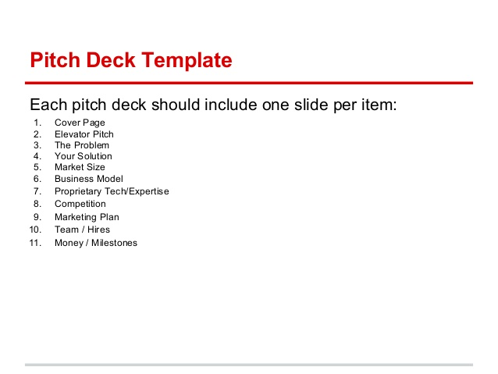
Pitch Deck

Slide 45
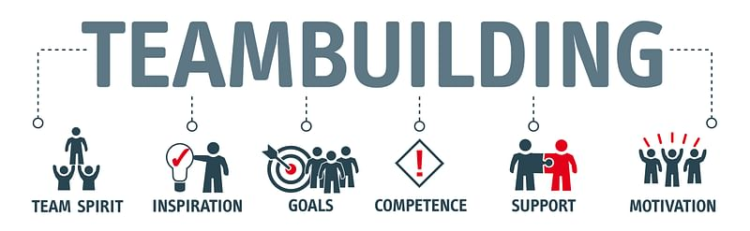
Building A-Team
"Teamwork makes the dream work, but a vision becomes a nightmare when the leader has a big dream and a bad team" – John Maxwell, Author
"There’s nothing wrong with staying small. You can do big things with a small team" -Jason Fried, Entrepreneur
"Great things in business are never done by one person "
-Steve Jobs, Co-Founder of Apple
“If you want to go fast, go alone; if you want to go far, go together.”
Thus, to take your startup to stellar heights, you need to start by building a winning team that will take you far.

Slide 46
Importance of Building A Startup Team
“No matter how brilliant your mind or strategy, if you’re playing a solo game, you’ll always lose out to a team.”
-Reid Hoffman, Entrepreneur
Study says that about 60 percent of startups fail to take off due to poorly constituted teams!
This statistic establishes the fact that behind every successful startup is a team of passionate individuals who work tirelessly towards a common goal.
Regardless of how awesome the idea may be, building a team for the startup lays down the stepping stone to success.

Slide 47
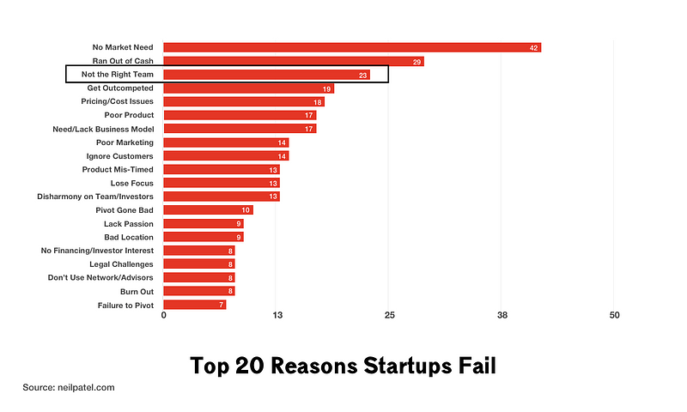
Importance of Building A Startup Team
Top Twenty Reasons Startups Fail

Slide 48
How to Build A-Team for a Startup?
Identify the doers from the sayers: It is important to have team members who are agile, resourceful, and quick rather than those who merely spout off facts.
Standard metrics don’t apply: Candidates who are passionate and self-driven to get things done could be much more valuable than someone who may appear competent but is ineffective.
Adapt, change, and improvise: Team building for managers involves changing, adapting, and improvising the team based on the gaps and future requirements.
Focus on customer service: A team that makes the customer feel like a priority and puts them first, then such a team is preferable.
Avoid homogeneity: Having a heterogeneous work atmosphere will provide room for creativity and individualistic ideas.

Slide 49
How to Build A-Team for a Startup?
Exercise strong leadership: Entrepreneur is responsible for ensuring collaboration so that the task or project outcome is as expected.
Hire slow, fire fast: A classic team building case study for the “Hire Slow” philosophy is Airbnb, which took about five months to hire their first employee. The “Fire Fast” policy ensures that only fitting candidates are present in the team.
Experience vs. raw talent: While both experience and raw talent are important, what every recruiter should look for is passion. The zeal for getting things done can never be compensated by experience or untapped potential.
Build a scalable team: Focus on building a team of leaders who can head their respective organisational units in the future.

Slide 50
Hiring the A-Team members
The people hired for a startup depends upon the specific business needs.
Employees hired should have the following key qualities:
flexibility,
passion and
trustworthiness.
It is important to hire people who are flexible enough to take on diverse responsibilities until further expansion.
When interviewing new-hire candidates, pose questions that probe a person's drive and how well suited they might be with your company's culture.
In addition, use hands-on simulations to get a sense for how the candidate will act in common work situations.
It's smart to hire from the top, then expand your team when your resources allow.
A major focus when hiring for startup roles is strengthening your business's internal and external relationships.
It's important to keep your company culture in mind when filling startup positions.

Slide 51
Pitching To Attract The Talent
Essential points in pitching to attract talent for a startup company:
Build An Attractive Company: The first step is attracting talent is creating a company that appeals to top-quality applicants, getting job advert in front of the right people, and getting them excited about working in the startup.
Defining and sharing your company values is a great starting point from which to evaluate prospective employees based on culture fit.
Competitive pay is essential for attracting talented employees, and it’s even more important for employee retention.
Reaching Candidates: Attending conferences, talks or tech meet-ups are great ways to network with potential employees.
Share next-hire requirements with your team, and encourage them to reach out to any of their contacts who they think would be a good fit for the role.

Slide 52
Pitching To Attract The Talent
Look at tech recruiters as product partners: Ensure that recruiters attend product meetings that involve roles for which they are hiring.
Armed with an understanding of the product roadmap and technical challenges, a great technical recruiter will provide objective insights around a candidate’s strengths, weaknesses and any potential red or green flags.
Integrate product and hiring roadmaps: Creating a hiring roadmap that ties directly to the product roadmap enables recruiters to reverse-engineer hiring needs and establish a clear set of company-wide priorities.
Communicate inside and out: Hire a technical recruiter with excellent communication skills when it comes to speaking, listening and exhibiting passion for the product space.
Recruiter should listen to the problem, understand the constraints and communicate solutions. These include hiring a contractor, promoting from within, focusing on the primary platform first and employing an agency.

Slide 53
Defining Roles in a Startup
Eight Startup Roles to Hire
1. Chief executive officer (CEO) and chief operations officer (COO): The CEO is typically the big-picture person who controls the company's direction, vision and culture, whereas the COO is primarily focused on the day-to-day operations to keep your business running.
2. Product manager: This team member manages the product strategy, vision and development. They typically work closely with the engineering and marketing teams to create and market the product.
3. Chief technology officer (CTO) and VP of engineering hybrid: A team member who specializes in technology and development is crucial for tech startups business's success.
4. Chief marketing officer (CMO): This team member will focus on the startup’s customers and how they view the product or service.
5. Sales manager: This team member will focus on generating new leads and bringing in money for the startup.
6. Chief financial officer (CFO): Experts recommend that startups outsource their accounting and finance roles, but hiring a CFO can be extremely helpful for the startup. It's essential that to have someone on the team who is responsible for the money and has an eye for detail to manage all aspects of the company's finances.

Slide 54
Defining Roles in a Startup
Eight Startup Roles to Hire
6. Chief Financial Officer (CFO): Experts recommend that startups outsource their accounting and finance roles, but hiring a CFO can be extremely helpful for the startup. It's essential that to have someone on the team who is responsible for the money and has an eye for detail to manage all aspects of the company's finances.
7. Business development manager: While similar to the sales manager, a business development manager finds ways to grow the business from both a marketing and sales standpoint. For example, this professional focuses on developing relationships or partnerships with other businesses to increase revenue and potential for growth.
8. Customer Service Representative: Customer service is a critical task every business should master. Building positive relationships with your customers and clients is the cornerstone of your brand.

Slide 55


